Slide 1
Accelerating Data Engineering Pipelines
Part 1: Data Storage

Slide 2
For each section, start the GPU task before going through lecture
To see lecture notes, make full screen and click the “notes” button

Slide 3
Welcome!

Slide 4
Main Goal:
How do we organize and process an unexplored dataset to produce actionable insight?
Notes:
We will start with the main goal of this course. Let’s say we are new hires at a startup, and we know that in order to move forward as an organization, we need to set up our company’s data to make it quick and easy to analyze. How would we go about doing that?

Slide 5
The goals of this course
Get used to many different data types / frameworks and how they operate on GPU vs CPU.
Understand how DAG based frameworks can speed up ETL
Learn how to visualize data to
Assess data quality
Allow users to make their own decisions through interactivity
Notes:
In order to achieve this main goal, we are going to break it down into three sub goals:
Build an understanding of the different data types available and how they operate on a GPU
Understand how to use a DAG to speed up an ETL pipeline
Help users find their own insights through interactive visualization

Slide 6
Agenda
Part 1: Data Formats
Part 2: ETL with NVTabular
Part 3: Data Visualization

Slide 7
Agenda – Part 1
Systems Engineering
File Formats
Data Frameworks
Lab

Slide 8
Systems Engineering
Notes:
Data Engineering is a huge field. There are constantly changing technologies and expectations. Keeping up with all of them can be quite a challenge.
The secret to adaptability is good system engineering techniques.

Slide 9
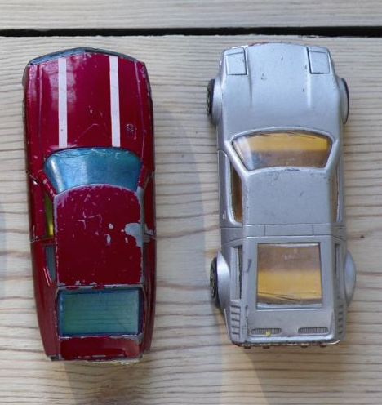
System Example
Modeling a Car
Tires
Energy
Lights
Let’s Ride!
Notes:
Systems engineering is the study of systems. This is a purposely vague term because it can cover so much.
For instance, data is usually the result of a data pipeline. For the end user who is doing analysis on a snapshot of it, it might be easy to think of data as a static entity, but for the data engineer, data is very much a living thing.
As a simple example, let’s think about what a car needs to run. It’s got four wheels, two headlights, and an energy source (electric, gas).

Slide 10
System Example
Modeling a Car
Tire 1
Tire 2
Tire 3
Tire 4
Light 1
Light 2
3/4
1/2
Tires
Energy
Lights
Let’s Ride!
3/3
Notes:
Even if this is an overly simple example, we can see how it can get exponentially more complicated the further we investigate the details.
We don’t need all four tires to get our car moving, although it does make our lives much easier. If we have one flat tire, we might be able to move along for a little bit to get to safety. If we’re negligent and wait to have more flat tires, we seriously risk permanently damaging our car. Because of that, let’s say we need 3 out of 4 tires to be operational.
Similar story with the headlights. At night, we can see ok with just one, but if we lose both, it would be tricky to see at all.

Slide 11
System Example
Modeling a Car
.99
.99
.99
.99
.98
.98
Tire 1
Tire 2
Tire 3
Tire 4
Light 1
Light 2
3/4 (.9994)
1/2 (.9996)
Tires
Energy
Lights
No go!
3/3 (.999)
Notes:
When we model our system out like this, it’s easier to see and predict failure modes.
Failure mode is the process of reviewing as many components, assemblies, and subsystems as possible to identify potential failure modes in a system and their causes and effects.
We can do some quick math to find the probability of these failure modes and find the weaknesses in our system.
Let’s say for any hour, our tires have a 99% chance to work. Our headlights also have a 98% chance to work. We might ask ourselves, what are the chances that at least two of our tires goes out? That would be 6 * .99 * .99 * .01 *.01 = .00058
We can then work down the tree and ask, what are the chances my tires don’t go out, but my lights do? With the numbers we have, our car has a 99.9% chance to work at any given hour. It is almost impossible to ever have perfect reliability, and it takes a lot of teamwork and planning to make complex systems seem seamless.

Slide 12

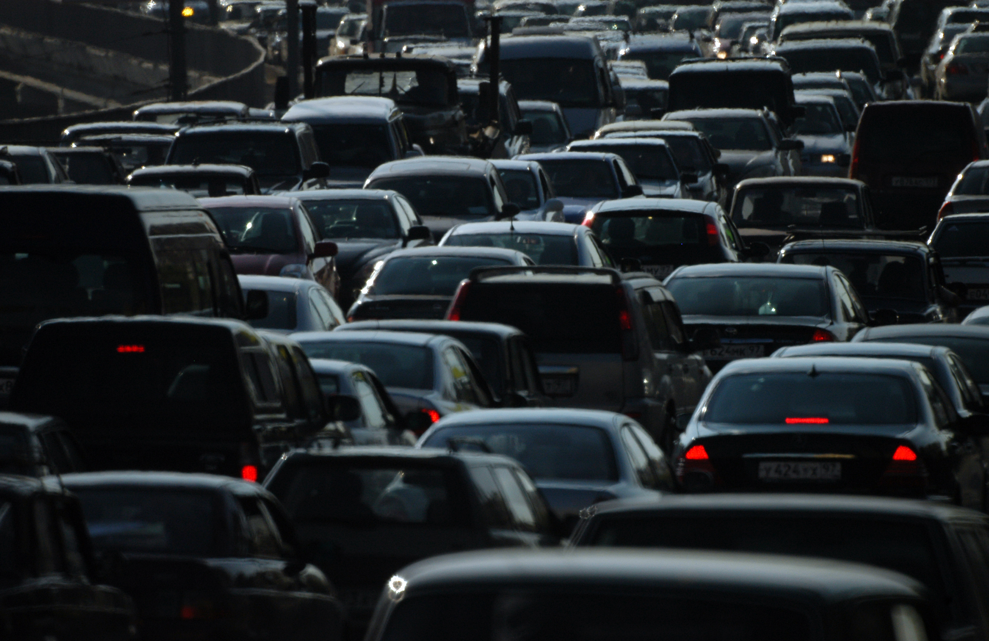
Systems Big And Small
Details
Big Picture
Notes:
It’s easy to get lost in the details. Do we want to break down the physics of each tire? We can go the other way too. Often, the system we’re studying is part of a large system. Do we want to account for other vehicles in the road? If their tires fail, could that impact us?
Defining an appropriate scope is something most engineers pick up with experience as data engineers must think both in terms of the big picture and in the details.

Slide 13
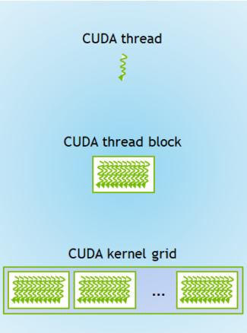


System Engineering for Data
Data Algorithms
Data Hardware
Data Exchange
Calculate Age
1: User asks for website
Client
Server
CPU
2: Server returns webpage
Calculate Age
Average Age
3: User requests filtered data
6: server returns filtered data
Calculate Age
Notes:
Once we get some practice modeling systems, it gets easier applying it to all sorts of systems. Actuaries use the same system engineering techniques to calculate the cost of insurance. Today, we’re going to by looking at data through a few different system perspectives:
Data as a system of algorithms
Data as a system of hardware
Data as an internet system

Slide 14
Data as a System of Algorithms
Notes:
Let’s look at what we mean when we say data is a system of algorithms.

Slide 15
Database System Design
Enhanced Entity Relationship Diagram
VIN
Model
Year
Entity
Car
1
Attribute
Has
M
Part
Relationship
UPC
Brand
Quantity
Notes:
It is often difficult to change the schema of big data once it is live, meaning, it is actively in use and collecting data. While it is possible to make changes, there is a big chance that moving things around can cause downtime for users. To prevent that, Database engineers collect as much information up front as they can before implementing their databases. One of the standardized ways of doing this is with an Enhanced Entity Relationship (EER) diagram.
Let’s use a car as an example again. We might think of each physical Car as an entity, which is represented by a square. In other words, while there are many kinds of cars out there, they all share several attributes (the circles). For our cars, this could be the “make” of the car, the “model” and the “year” it was made. In the United States, each car is tagged with a Vehicle Identification number. Since this is unique to each car, we can use it to quickly identify any particular car in our data. Such a unique identifier is called a key.
The car is also made up of a bunch of parts: the tires, headlights, and energy source among other things. We are going to keep it simple here and group them into one category so users can quickly find a part they are looking for with its Universal Product Code (UPC). A part can only be in 1 car at a time, but a car is made of many (M) parts.

Slide 16
Database System Design
From Design to Practice
Cars.csv
Cars.json
VIN, Model, Year
1a2b3c, Sedan, 1986
4d5e6g, Convertible, 2011
7h8i9j, Sedan, 1997
VIN, UPC, Brand, Quantity
1a2b3c, 8675309, Generic Lights, 2
1a2b3c, 8675310, Generic Tires, 4
4d5e6g, 8675309, Awesome Lights, 2
4d5e6g, 8675310, Awesome Tires, 4
{[
{“VIN”: 1a3b3c,
“Model”: “Sedan”,
“Year”: 1986,
“Parts”: [
{“UPC”: 8675309,
“Brand”: “Generic Lights”,
“Quantity”: 2
}, {
{“UPC”: 8675310,
“Brand”: “Generic Lights”,
…
Parts.csv
Notes:
Once we’ve gathered the requirements of our data, it’s time to decide what format the data should be stored in.
If we were to use a tabular format like Comma Separated Values (CSVs), then each entity would be a row in our table while the attributes corresponds to columns. Since we have two kinds of entities here, we might end up with two different CSV files: one for Car and one for Part. If we want to link the two files together, we might do so with a foreign key. We could add a column in our “Part” file with its parent’s Vehicle Identification Number (VIN)
Alternatively, if we want to store both entities in a flexible file format, we might try something like a JavaScript Object Notation (JSON) file. This way, we can embed Part as a field in the Car entity.
As we can visually see, CSV is more compact than JSON, but it is not as flexible. There are many file types with different kinds of trade-offs depending on the environment they’re used in. We will go over them shortly.

Slide 17
Database System Design
Directed Acyclic Graphs
Calculate Age
Map
Calculate Age
Average Age
Reduce
Calculate Age
Notes:
But first, let us consider this: EER diagrams are great if all we need are entities, but what if we want to do some analysis? What if we want to create a new attribute from other attributes or derive some insight built from all entities?
In such a case, we would have a system of operations. For instance, what if we want to find the average age of a car in our database, but our database has been partitioned into multiple files based on the year of the car. No problem, for each file, we’ll take every car and calculate its age. Then, we will pool all the ages together to calculate the average.
Such an operation is called MapReduce because we’ve mapped an operation to each entity and then reduced the result of those operations into one descriptive number.
In general, data pipelines make heavy use of these MapReduce functions. We will go into why soon, but for now, we can observe that it creates a visual graph. These graphs are directed, meaning we move from one operation to the next, but never in the reverse order. They are also acyclic, because if we create a loop in our operations, our pipelines will run forever. Hence, these types of graphs are called Directed Acyclic Graphs, or DAGs for short.
Thankfully, as we will see in the hands-on labs, many data pipeline tools will automatically build these pipelines for us. Additionally, they come with visualization tools so we can verify the operations of our pipelines.

Slide 18
Database System Design
Data Quality
VIN
Model
Year
Calculate Age
Car
1
Calculate Age
Average Age
Has
M
Part
Calculate Age
UPC
Brand
Quantity
Notes:
This is important because every operation can be what is called a Single Point of Failure (SPOF). A SPOF is a part of a system that when it fails, it brings down the whole system. These types of failures are particularly tricky to debug because
The bug might not surface until later in the data pipeline
In the case of calculating something like an average, an obviously bad value could be masked by the good values. For instance, if we have an age of -1 sneak in with ages 3 and 4, we will end up with an average age of 2, which sounds valid.
To prevent these scenarios, data engineers have a series of checks or tests along their pipelines.

Slide 19
Database System Design
Directed Acyclic Graphs
Calculate Age
MapReduce
Drivers
ETL
Join on VID
Denormalized Table
Average Age
Cars
Calculate Age
Network Routing
Calculate Age
B
D
B
D
A
A
C
E
C
E
Notes:
DAGs are a powerful way to represent many systems. As long as it can be completed in a finite amount of time, many data processing pipelines large and small can be represented as a DAG. The source would be the original memory location of the data, and the sink (end) would be the destination memory location. Even In-place data transformations make use of auxiliary variables with their own physical location within computer hardware to be communicated within a computer system.
Another example besides MapReduce include Extract, Transform, and Load (ETL) data pipelines. The internet itself is perhaps the largest data system in the world. For data to be sent from one node to another, it needs to find the shortest path within a weighted directed graph of nodes. While these initial paths may have cycles in them, the result of many shortest path algorithms can produce a DAG from a source to its potential targets. (If the result still has a cycle in it, then that would imply there are multiple paths to the target node with increasingly infinite lengths, which would be a contradictory solution)

Slide 20
File Formats
Notes:
As promised, let us look at various file formats and their strengths and weaknesses.

Slide 21
Data Formats
Pick 1 - 2
Flexible
Supports unique schemas
These definitions vary based on context:
Scalable to read or to write?
Scalable with speed or cost?
Flexible in the data store or flexible in the application?
Functional for the server or functional for the client?
Functional
Usable in many contexts
Scalable
Works well with many data points
Notes:
https://en.wikipedia.org/wiki/File_format
Typically, the more structured a file format, the more scalable it is. There is some nuance to this however, such as the type of environment the data processing is being done on. (Single server vs multiple servers).
A flexible data format would be something like a binary string. This is a sequence of bytes and is used for non-traditional data formats such as images, due to its flexibility. Unfortunately, by itself, it’s not very functional as another program needs to know how interpret the string before it can be used. https://www.postgresql.org/docs/8.1/datatype-binary.html
A functional format would be something like json. Because the data is human readable and because of its tree like data structure that can support quickly reading a writing multiple data types, it is used in many applications. Almost every web application likely uses json so users can quickly interact with websites through a variety of ways, such as clicking a radio button, typing in a text field, or selecting a date from a calendar. Json can be sent back and forth between front end and backend as data is stored and retrieved from backend databases. Json is semi structured, so it doesn’t scale as well to millions or billions of datapoints… https://www.json.org/json-en.html
A scalable format would be SQL. SQL is very structured where data types and size must be specified. It can be stored in an indexed table making it even quicker to search and filter information. SQL is part of an ecosystem that is both data format and query language. SQL as a language is straightforward, and there are lots of things users can do with it, but it is not as functional as JSON or flexible as binary.

Slide 22

Picking the Best Format
CRUD
Create
Add a record
Read
Get record
Update
Change a record
Delete
Remove a record
Notes:
https://dataschool.com/data-modeling-101/row-vs-column-oriented-databases/
So how do we know what type of dataset is best for us? This very much depends on what we will be doing. One way to think of it is this: there are four common operations for almost every database people refer to as CRUD. Create, Read, Update, and Delete.
Let’s start with Read. Let’s imagine we have some graph paper with our friends’ contact information on each row. Computers look at data files very similarly to how we would as humans, they just have the advantage of moving much faster. So, if it takes a while for us to find the data we want in a data file, it will probably take the computer a while to find it too. If we don’t number the rows or the columns in our graph paper, it might take us a while to find the right cell. Let’s say that there’s so much data that it can’t fit on one sheet. It would be useful if we could have some indicator at the top and bottom of each page so that it’s easier to find a specific cell if we have to flip trough all the pages. If our friends are sorted, we can say that a page is dedicated to a last name initial, like this page is for people whose last names start with N.
Next, let’s think about Create. If our friends are unsorted, that’s easy, we can add a new friend to the last row. If our friends are sorted, it’s more complicated. If our friend’s name starts with A, would we have to push everyone down a row in order to add them? If we have multiple pages, do we need to change the headers and footers?
How we structure our data is going to depend a lot on what our circle of friends is like. Do we go for quality friendship over quantity friendship, so we barely fill one page? Do we have so many friends, we need to fill multiple books? Are we the only users of these books, or are multiple people going to be looking at them at once? Do all of our friends’ names start with NV so it would be pointless to list just the beginning initial in the page header?

Slide 23
Row vs Columnar Storage
- Row -
Efficient for
Adding a new record
Formats
CSV (Comma-Separated Values)
TSV (Tab-Separated Values)
Apache AVRO
Engines
MySQL
PostgreSQL
| Columnar |
Efficient for
Data Aggregation
Formats
Apache Parquet
Engines
BigQuery
Snowflake
Redshift
Notes:
Our graph paper analogy does have one flaw in that humans can switch between scanning row by row versus column by column easily. Unfortunately for computers, unless we give them the exact location of something (row x, column y, page z), it will search through data line by line. So, when we choose a data format, we need to decide whether a line represents a row or a column. (In rare cases, a line can represent a row and a column, but this is usually for sparse data).
In general, GPUs digest columnar data more quickly than row data. Let’s talk about how they’re used in practice to understand why.

Slide 24
Writing
Adding a New Entry
Row Formatted Data
First | Last | Born
Grace | Hopper | 1906
Blaise | Pascal | 1623
Katherine | Johnson | 1918
+
Alan | Turing | 1912
Column Formatted Data
Grace | Hopper | 1906
Blaise | Pascal | 1623
Katherine | Johnson | 1918
Grace | Blaise | Katherine
Hopper | Pascal | Johnson
1906 | 1623 | 1918
Alan
Turing
1912
Alan | Turing | 1912
Can concatenate to end, or inserted by row number
Broken up and inserted at the end of each block
Notes:
https://mangatmodi.medium.com/rowise-vs-columnar-database-theory-and-in-practice-53f54c8f6505
Row formatted data is best suited when records (or entities) are constantly created or deleted from the database. We can see here, we can just concatenate it the end of the file, or we can insert it by row number. In order to do the same for column formatted data, we would need to break up the record by attribute and loop through each line in the file to find the best place to add it. In other words, we would have to read through most of the database to add a record!

Slide 25
Analysis
A.K.A Feature Engineering
Row Formatted Data
First | Last | > | In.
Grace | Hopper |  | GH
Blaise | Pascal |  | BP
Katherine | Johnson |  | KJ
Alan | Turing |  | AT
Column Formatted Data
Grace | Hopper |
Blaise | Pascal |
Katherine | Johnson |
GH
Grace | Blaise | Katherine |
Hopper | Pascal | Johnson |
BP
KJ
GH | BP | KJ
Broken up and inserted at the end of each block
Can be concatenated to end or inserted by column number
Notes:
On the other hand, column formatted data is great for analysis. If we want to create a new column using some combination of the other columns, we would only need to look at the relevant columns to our query.
For row formatted data, we would need to scan through every row in order to do the same thing!

Slide 26
Binary
Ex: Multimedia File
Pro
Con
Hard to visualize without decoding software
Compact
Faster to send and process
Flexible
Many datatypes can easily be converted to binary
Great for images
Difficult to debug data integrity
Notes:
https://en.wikipedia.org/wiki/Binary_file

Slide 27
ASCII
Ex: CSV
Pro
Con
Simple structure
File is human readable
Simple structure
No file metadata
No file metadata
Average scalability
Data is not compressed as much as other file types
Average scalability
Easy to join and split multiple CSV files
Easy to append a new entry
Notes:
https://www.upsolver.com/blog/apache-parquet-why-use
https://stackoverflow.com/questions/36822224/what-are-the-pros-and-cons-of-parquet-format-compared-to-other-formats
CSV is very “middle of the road”. It’s easy to manipulate hundreds to thousands of CSV files that share the same schema because it’s just a matter of concatenating or splitting the files. On the other hand, there is no data compression, so if there are frequently reoccurring values, there could be much wasted space.

Slide 28
Parquet
Ex: Hadoop
Pro
Con
Immutable
Good compression if many repeated values
Querying for all the attributes of an entity is an expensive operation
Efficient to read a subset of columns
Query results are typically saved in a new file
Support for complex datatypes like arrays
Files are not human readable without a tool
Notes:
https://www.upsolver.com/blog/apache-parquet-why-use
https://stackoverflow.com/questions/36822224/what-are-the-pros-and-cons-of-parquet-format-compared-to-other-formats
https://stackoverflow.com/questions/53982871/pandas-reading-first-n-rows-from-parquet-file
Parquet is often cheaper and faster than CSV for analysis because we can limit interaction with just the columns, we are interested in. That said, it is an expensive file type for “SELECT * LIMIT 10” type of operations. We may need to read in multiple values in a column to find the value relating to just one particular entity.

Slide 29

Data formats comparison
Summary
Properties | CSV | JSON | Parquet | Avro
Columnar
Compressible
Splittable
Human readable
Complex data structure
Schema evolution/validation
Binary

Slide 30
Data Frameworks
Notes:
Just as there are many different kinds of data, there are many different data frameworks in order to view and analyze that data. We’re going to go over a few of the popular ones.

Slide 31
Vertical vs Horizontal Scaling
↑ Vertical ↑
Scales to higher quality hardware
SQL
CuPy
NumPy
cuDF
pandas
← Horizontal →
Scales to more partitions / machines
Dask
NoSQL
Spark
Hadoop
Notes:
https://www.section.io/blog/scaling-horizontally-vs-vertically/
Besides the different kinds of data that they handle, some frameworks scale better with higher quality hardware (better CPU, RAM, Disk Memory, GPU) and some scale better with more machines. Some frameworks can scale with both, but there is a balance. When using multiple machines that speak over the internet, there is added latency as data travels over the internet. It’s worth asking, would a GPU be sitting idle while that data is in flight?

Slide 32
SQL
Structured Query Language
Query
Table
(awesome.people)
SELECT first, last
FROM awesome.people
WHERE born > 1900
first | last | born
Grace | Hopper | 1906
Blaise | Pascal | 1623
Katherine | Johnson | 1918
Alan | Turing | 1912
first | last
Grace | Hopper
Katherine | Johnson
Alan | Turing
Result
Notes:
As mentioned before. SQL isn’t just a data structure, but also an ecosystem. SQL stands for Structured Query Language and works like so:
SELECT is the columns we want to query
FROM is which table (data source) we want to query from
WHERE allows us to filter which rows we want return.
Traditional MySql is limited to one machine. It can scale vertically with GPUs by using Blazing SQL.

Slide 33

DataFrames
Pandas (CPU) and cuDF (GPU)
Query
Table
df
df = df[df[“born”] > 1900]
df = df[“first”, “last”]
first | last | born
Grace | Hopper | 1906
Blaise | Pascal | 1623
Katherine | Johnson | 1918
Alan | Turing | 1912
first | last
Grace | Hopper
Katherine | Johnson
Alan | Turing
Result
Notes:
SQL is fast and is the database of choice for many large data warehouses. That said, SQL is not a very flexible language.
We can keep the same table structure while adding in the flexibility of python while using DataFrame tools like pandas and CuPy. Pandas and CuPy are very similar, but pandas works with the CPU + RAM while cuDF is GPU based.
If we want to filter data like we did with our SQL example, pandas/cuDF has its own querying rules as described here:
https://pandas.pydata.org/docs/getting_started/intro_tutorials/03_subset_data.html

Slide 34
Matrices And Number ARRAYS
NumPy (CPU) and CuPy (GPU)
Query
Array
a
a = a.sum(axis = 0)
8 | 6 | 7
5 | 3 | 0
9 | 8 | 6
7 | 5 | 3
Result
29 | 22 | 16
Notes:
We will not be using it much in this class, but if we are working with purely numeric data, we might consider NumPy or CuPy, which are optimized to work with matrices.
People often go between DataFrames and NumPy arrays depending on what data manipulation they are trying to do, and it’s easy to convert from one to the other. Pandas is even built on top of a bit of NumPy.

Slide 35
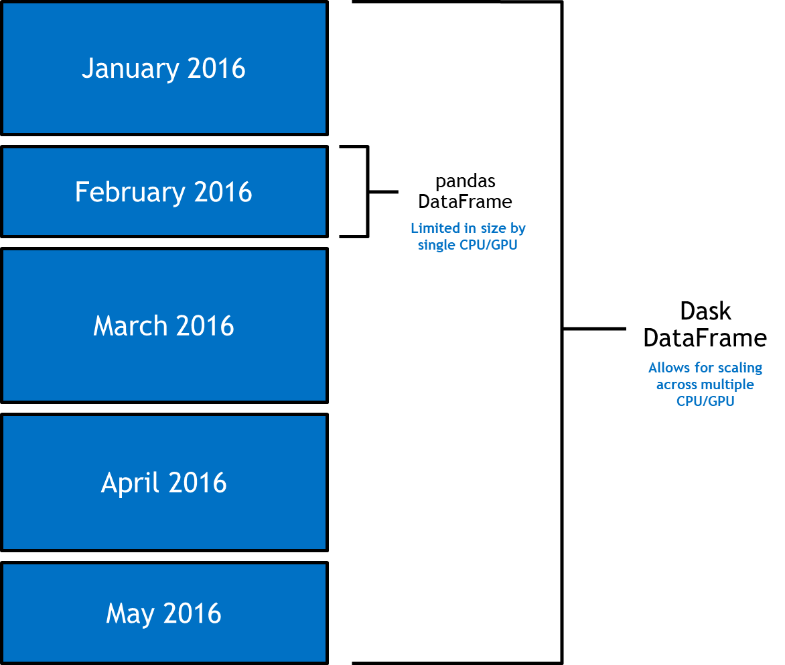

DASK SCALES PYTHON ANALYTICS
SCALE FROM A LAPTOP TO LARGE-SCALE CLUSTERS WITH EASE
Time Series Data
Dask enables data scientists to scale out analytics workloads in native Python. With an optimized scheduler, Dask makes it easy to schedule and execute tasks on distributed computation.
Dask follows the standards set by the PyData ecosystem to provide a familiar, comfortable user experience at scale. When paired with NVTABULAR/RAPIDS, data scientists can leverage the processing power of NVIDIA accelerated compute and distribute across clusters to improve cycle time-reducing time to insights drastically.

Slide 36
MapReduce
Map to each thread, Reduce all threads to one
Calculate Age
Map
Calculate Age
Average Age
Reduce
Calculate Age
Notes:
There’s a bit of an art to setting up our computation. The more we can take advantage of our parallel threads, the faster the computation will be.
The concept is built on MapReduce. If we have a function that can work independently on each thread, then we can Map that function. This is fast because if one thread takes a little longer, it is not slowing any of the other threads down.
If we need our threads to communicate with each other, say we’re taking an average, we can Reduce that down to one thread. This can be a potential bottleneck as we will need to wait for all of our threads to finish their previous process before we can finish calculating the result.

Slide 37

Lazy Execution
Building a Factory
DAG
Calculate Age
Calculate Age
Average Age
Calculate Age
Notes:
By the way, Dask uses something called Lazy Execution. When we set up our code, Dask will start by building the DAG. If we print out a variable, it might give us the shape and type of it, but not any of the numbers. That’s because the data has yet to be run through the DAG.
Why do it this way? We can think of it as setting up an assembly line. If we build an assembly line, we don’t have a product yet, but it will make it much easier to scale and make lots of products. It’s exactly because of this design that Dask can scale to data larger than can be stored in our DRAM or GPU.
To force a result, we can use the “compute” method.
We can store intermediate results in order to reuse them. If we are confident the step of an operation is consistent, this can make our computation quicker.
Lazy execution can be seen as a cache, but a cache is not always lazy execution.

Slide 38
Relational Databases
Ex: SQL
Pro
Con
Inflexible data structure
Well known
Concise Language
Relatively fast querying
Foreign keys
Blazing SQL
Some objects do not convert well to table format
Typically, single server
More expensive hardware needed to scale
Notes:
https://capgemini.github.io/design/sql-vs-nosql/
https://www.cise.ufl.edu/~mschneid/Research/papers/HS05BoCh.pdf

Slide 39
DataFrame
Ex: cuDF, Pandas, R
Pro
Con
Single server, not meant for large-scale data manipulation
Python and R APIs
cuDF, Pandas
Compared to SQL, more flexible operations
Easier to make user-defined functions and integrate third party libraries
Consider Spark instead
Compared to SQL, not as scalable

Slide 40
Dask
Ex: Dask DataFrame, Dask-cuDF
Pro
Con
Large overhead to set up not worth it for small files or limited computation
Large computation can receive a significant speed increase
Can read large data sources due to partitioning
Lazy execution can make it tricky to debug

Slide 41
Lab

Slide 42

Weather Systems
Credit: Ralph F. Kresge, Submitted to NOAA
Notes:
Speaking of systems, during this course, we will look at one of the most complicated systems known: the weather. The National Oceanic and Atmospheric Administration (NOAA) has many online publicly available datasets that we will be sampling.
Permission to use photo: https://photolib.noaa.gov/About
https://photolib.noaa.gov/Collections/National-Weather-Service/Weather-Wonders/Rainbows-Halos-Reflections/emodule/657/eitem/2605

Slide 43
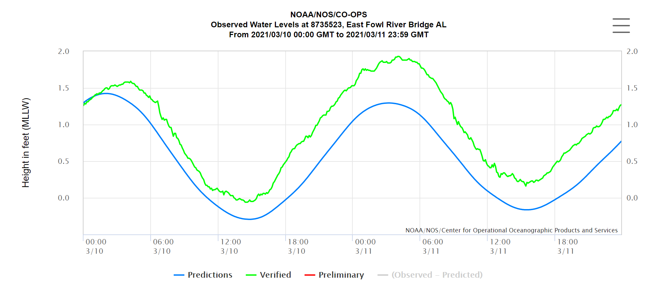
Investigating Water Level
Notes:
For the upcoming lab, we will learn how to pull data directly from a live data engineering pipeline using NOAA’s Center for Operational Oceanographic Products and Services (CO-OPS) API. We will then use various frameworks to read and transform the data.
If you have extra time, we highly recommend exploring the NOAA website as it is very impressive how much data they manage. See if you can figure out how they build their interactive graphs like the one above.

Slide 44
Let’s go!
Notes:
Good luck with the lab!

